Slide 1
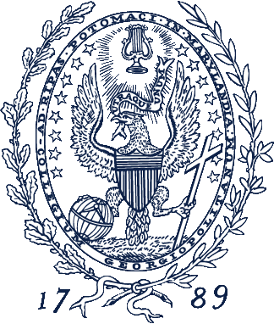
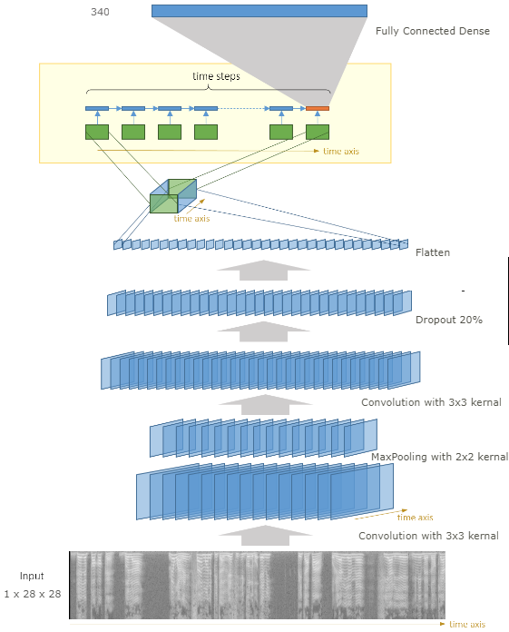

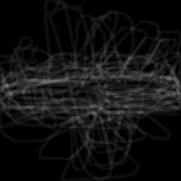
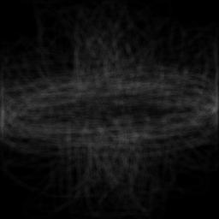
Doodle Image Recognition Using CNN+LSTM Model
Fengdi Li, Yarou Xu, Yifan Wu
Georgetown University
Goal & Objectives
In this project, our goal is teaching the computer to recognize doodling. After training on pre-labeled sketches, we expect that the model will recognize any drawing that belongs to these pre-trained categories. Our further focus is to investigate whether the style of doodling is different between players from the U.S. and China.
Approach & Performance
Our model will have a CNN + LSTM architecture. The CNN contains convolutional layers, pooling layers and fully connected layers with drop-out. It can take in a freehand sketching graph in the format of vectors of pixel points and decrease the dimension of features by extracting major information from the large input pixel matrix. Then we use LSTM units to learn the extracted information since LSTM performs excellently in dealing with sequential data. We think that strokes in the freehand sketching are always interdependent with each other, which makes the LSTM a suitable tool for processing freehand drawing data. We hope that the LSTM units can capture and memorize relationships between neighbor pixel points, so that the model can better understand the sketching.
Model Accuracy Comparison:
By visualizing the aircraft as an example category of doodle images from two countries, we observed that China’s doodling is more variant than U.S., which indicates the using China model to test the accuracy of U.S. image will produce a slightly different result, vice versa.
Discussion
This model was only trained on black-and-white freehand sketching, therefore, it may not be able to classify other types of images accurately, such as realistic photographs with RGB colors.
The second limitation is that we only trained on a subset of examples of each image categories for time and difficulty saving purposes. When we increased of increase the sample size, the test accuracy improved.
Our model's performance is deeply dependent on the quality and size of the training data. Compared with the Chinese drawing data, the US drawing data is much balanced, therefore, the overfitting problem is alleviated, and the validation accuracy increased.
The converging speed of CNN+LSTM is a lot faster than basic CNN model, which achieved a comparably high training accuracy within few epochs.
Data
We used the preprocessed data provided by the Google AI game “Quick, Draw!”. This dataset is a collection of 50 million drawings across 341 categories which are all contributed by the player of this game.
Successful models have been trained using this dataset, thus, it will be the appropriate data to use if we want to make changes to the model networks structure.
Due to the computing and storage memory limits, for each category in U.S. model, we trained our model on 100 and 1000 recognizable samples collected by the game, while used the full samples in China model.
Each hand-drawn training picture is a vector that tagged with metadata such as what the players are asked to draw, the player’s country, and stroke positions of this drawing.
We preprocessed stroke data into image matrices, and uniformly rendered them into 28 ×28 grayscale bitmaps.
Conclusion
The CNN-LSTM model, built in this study, can be used to identify trained U.S. and Chinese doodle images belongs to 340 common categories, but worse in validation and cross test accuracy compared to baseline CNN model. And the doodling images are slightly different between U.S. and China.
Reference
Recurrent Neural Networks for Drawing Classification | TensorFlow. (n.d.). Retrieved from https://www.tensorflow.org/tutorials/sequences/recurrent_quickdraw
Googlecreativelab. (2018, November 26). Googlecreativelab/quickdraw-dataset. Retrieved from https://github.com/googlecreativelab/quickdraw-dataset
Brownlee, J. (2017, July 19). CNN Long Short-Term Memory Networks. Retrieved from https://machinelearningmastery.com/cnn-long-short-term-memory-networks/
Assessment Metrics
Multi-class cross-entropy loss function integrating with a regularization penalty as the loss metric: Because the output of our model after the SoftMax layer is the probability of each category which ranges from 0 to 1, when the actual outputs are close to the desired outputs for all training inputs, the cross-entropy will be close to zero. Otherwise, the larger differences between the actual outputs and desired outputs, the larger cross-entropy loss.
Training-Validation Split & Cross Test between countries: We used the original Google AI Quick Draw dataset evaluate our model, and the ratio of the test set over the training set is 2:8. Also, we tested the U.S model using the China images and test the China model using the U.S. images.
Convolution neural net baseline model: We trained a basic CNN base model, and generated our final product by adjusting several hyperparameters, such as the number of convolutional layers, the number of LSTM layers, the embedding matrix dimensions. Also, we added pooling layers between convolutional layers to decrease input dimensions and added drop-out layers to avoid over-fitting and force hidden units to learn more information.
 | U.S. Model |  |  |  | China
 | 100 |  | 1000 |  | All
Accuracy | CNN | CNN+LSTM | CNN | CNN+LSTM | CNN | CNN+LSTM
Training | 54% | 99% | 33% | 62% | 89% | 99%
Validation | 41% | 33% | 47% | 54% | 17% | 11%
Cross Test | 38% | 31% | 43% | 49% | 14% | 12%
Acknowledgements
We would like to thank every participant playing the ‘Quick, Draw!’, which form the foundation of this study. We would also thank Dr. Joshuah Touyz for the guidance of deep learning theories and technique applications.
China Aircraft
U.S. Aircraft

